Slide 1
Maize Presentation

Slide 2
overview
Introduction into previous literature
Methods of previous literature
Results of previous literature
Updated Methods
Updated Results
What's Next

Slide 3
introduction
Food Insecurity continues to be a serious concern for many South Africans
In 2018, 11% of individuals and 10% of households in South Africa were vulnerable to hunger
Undernourishment slightly increased from 5% to 6% from 2014 to 2017
In 2014-2015, 22% of households experienced food insecurity due to a severe drought and subsequent food price shocks
White maize serves as a staple food for the majority of the population, specifically for low-income households

Slide 4
Most research evaluating the impacts of GM crops focuses on the producer benefits of GM input traits or the influence of consumer valuation and acceptance in GM crop adoption
- Specifically, the producers that have benefited the most are low income farmers in developing countries where there are fewer options for pest management and crop vulnerability tends to be higher
- Other findings conclude GM input traits have second-order socioeconomic impacts such as labor-savings and environmental benefits
- Many skeptics suggest that there is not clear evidence that GM maize has yield gains in South Africa that benefit producers

Slide 5
In a study done by Shew et al 2021, yield gains were found in GM maize both white and yellow.
- Yield increase is estimated at .42Mt ha from genetic modification
- GM maize also reduced yield risk by 8%
- GM yield gains vary under different conditions including different provinces and irrigated conditions, but GM yield gains are approximately twice as large for white relative to yellow maize

Slide 6
The data for the previous study was collected from 106 locations and 491 cultivars across 28 years and contains 58,952 observations.
- Data contained both white and yellow maize, with 41% of the data being white maize
- Most trials were dryland and rainfed but 17% were irrigated
- While the data begins in 1980, GM cultivars do not appear until 1999
- **more details on trials?

Slide 7
Data
For our current study, we took the previous data that ranged from 1980-2008 and added on data from 2009-2019.
- While the methods of collection were the same, this study is being conducted in R instead of Stata
- Newer data was compiled and cleaned in the same manner as the previous data
- regressions included a linear model and a quadratic model where yield was observed based on provence, year, technology, and color.

Slide 8
Summary of Data

Slide 9
- info on stata methods

Slide 10
Regression table Snippets

Slide 11
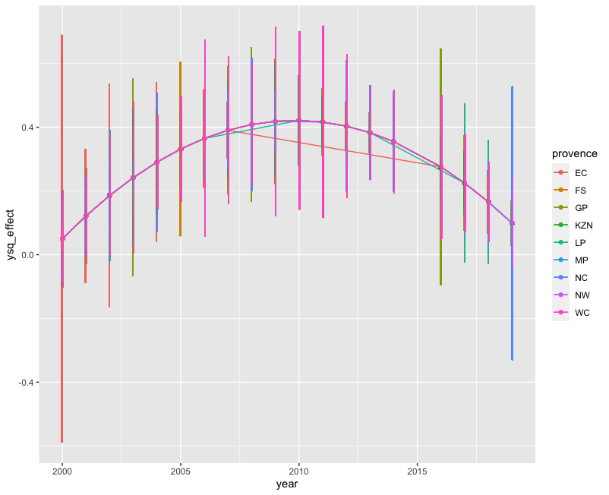

Slide 12
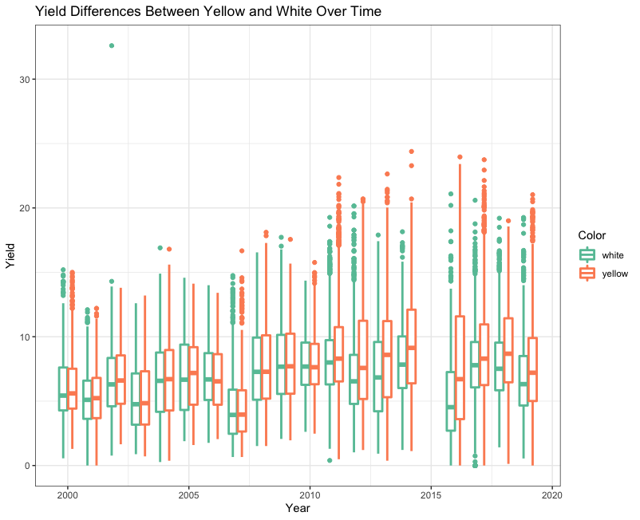

Slide 13
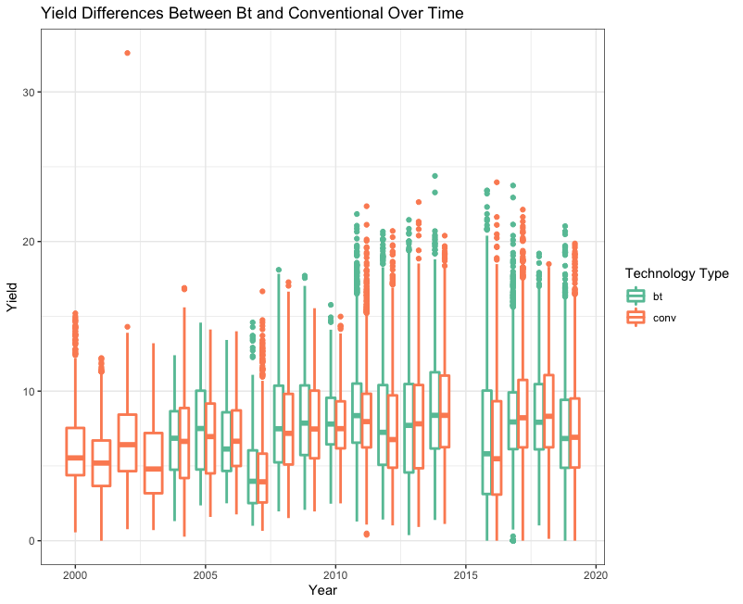

Slide 14
Next steps
Discuss the issue of insect resistance – what’s being done.
How will we estimate the economic and production impacts of insect resistance – just talk about what you hope to do next in this work.
Maybe talk about breakpoint analysis

Slide 15
Questions

